Slide 1


Hotel Ratings Prediction
Presented By: Ashjan Basri & Samah Alrifai

Slide 2
Outline
Introduction
Goal
Project Methodology
Data set
Proposed model
Results

Slide 3
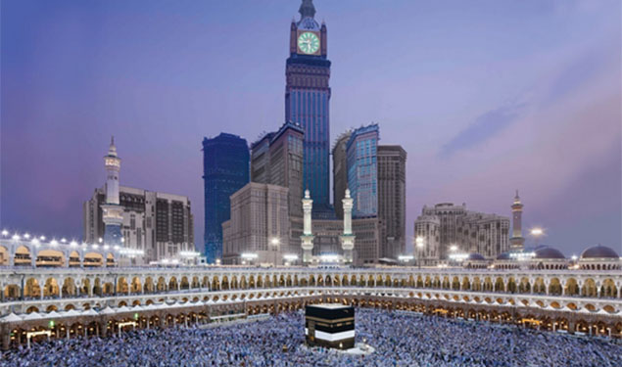
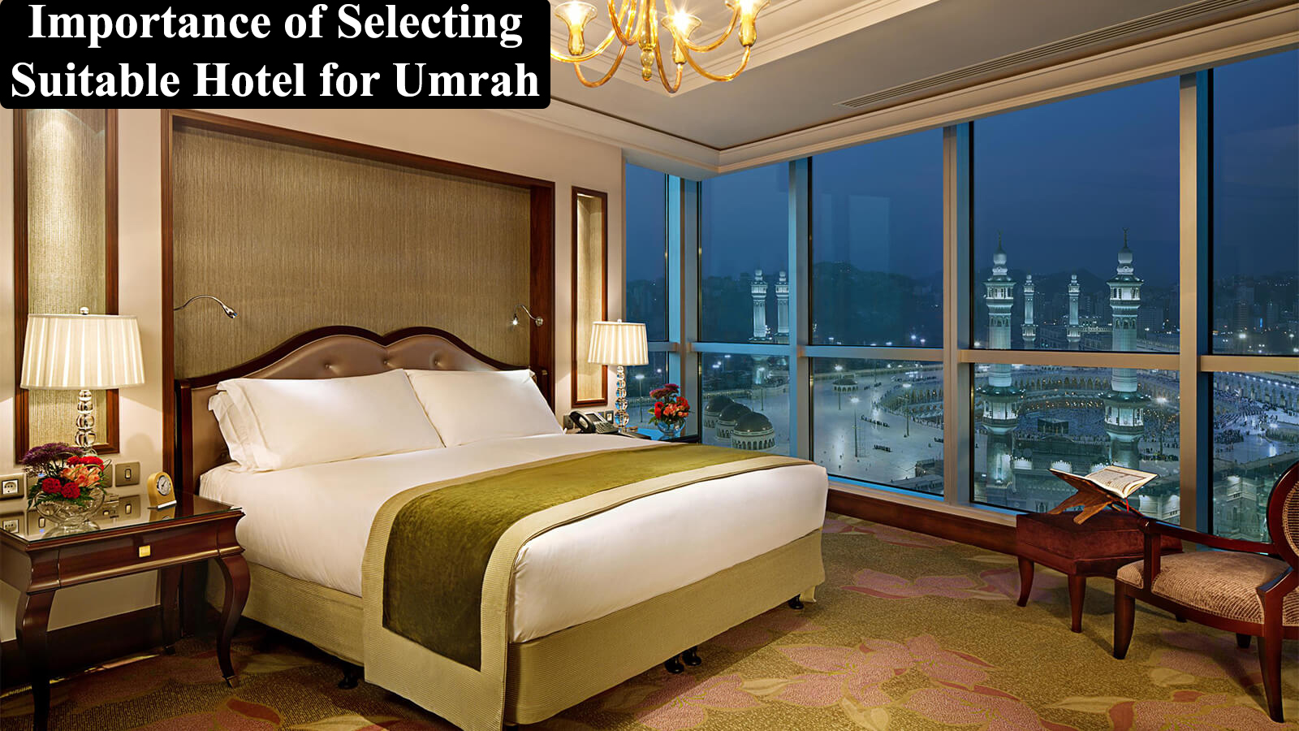
Introduction
Booking.com is the world’s leading digital travel companies. In line with the company’s mission Save time, save money!.
In Makkah there are about 39 hotels.
Ministry Of Haj and Umra to have more than 30 million pilgrim per year.

Slide 4

Goal
Our goal is to use highest seasons in Saudi Arabia such as Ramdan and Hahaj and apply our trained model to predict hotels reviews based on its locations.

Slide 5
Methodology
Web scraping
Data cleaning
Feature Engineering and selection
EDA
Model Selection and results
Train & Evaluate Model

Slide 6
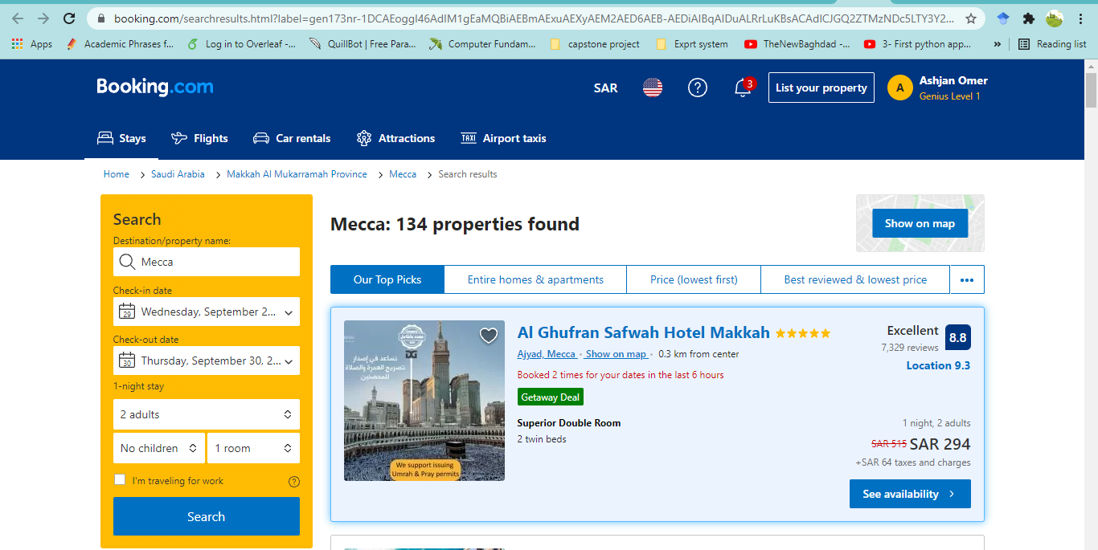

Methodology
Web scraping
Web scraping
Data cleaning
Feature Engineering and selection
EDA
Model Selection and results
Train & Evaluate Model
Original data: 235 datapoints, 5 features
Final data: 329 datapoints, 7 features

Slide 7

Methodology
Data cleaning and feature engineering
Web scraping
Data cleaning
Feature Engineering and selection
EDA
Model Selection and results
Train & Evaluate Model
Remove the string values from numeric
Drop columns are not need it such as hotels name.
Convert values type to float such as hotel rating and distance columns.

Slide 8
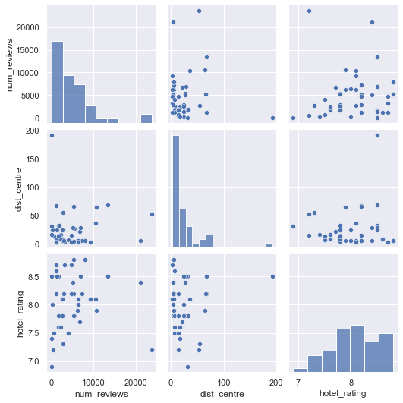
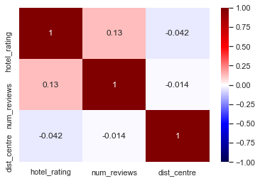
Methodology
Expletory Data Analysis
Web scraping
Data cleaning
Feature Engineering and selection
EDA
Model Selection and results
Train & Evaluate Model

Slide 9
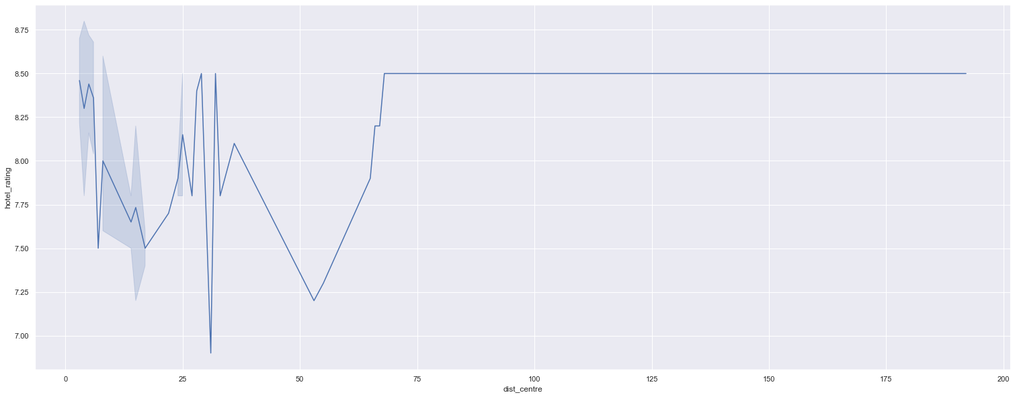
Methodology
Expletory Data Analysis
Web scraping
Data cleaning
Feature Engineering and selection
EDA
Model Selection and results
Train & Evaluate Model

Slide 10
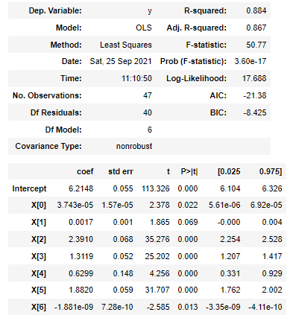
Methodology
Train and evaluate model
Web scraping
Data cleaning
Feature Engineering and selection
EDA
Model Selection and results
Train & Evaluate Model
BASELINE MODEL
CAN WE IMPROVE THE MODEL?
6 features with
p-values <0.05

Slide 11
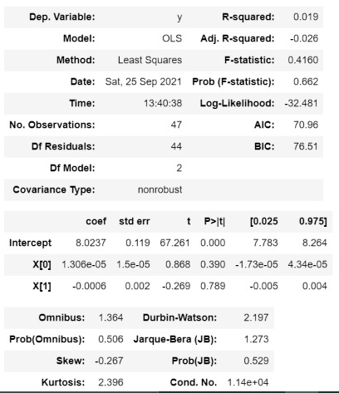
Methodology
Train and evaluate model
Web scraping
Data cleaning
Feature Engineering and selection
EDA
Model Selection and results
Train & Evaluate Model
features with
p-values <0.05
CAN WE IMPROVE THE MODEL?

Slide 12
Methodology
Model evaluation
Web scraping
Data cleaning
Feature Engineering and selection
EDA
Model Selection and results
Train & Evaluate Model
Evaluation methods on Training set
Model Type | Training | Validation | R²
Linear Regression M1 | 0.860 | 0.502 | 0.884
Linear Regression M2 | 0.902 | 0.519 | 0.019
LASSO | -5.717 | -5.817 | -
Ridge | -6.317 | -6.416 | -

Slide 13
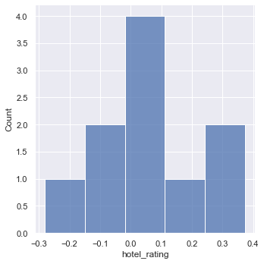
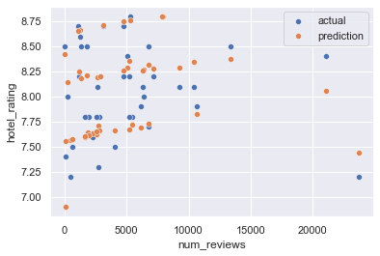
Methodology
Test and evaluate model
Web scraping
Data cleaning
Feature Engineering and selection
EDA
Model Selection and results
Train & Evaluate Model
Accuracy on Testing model
 | Final Model
R² | 0.890
MAE | 0.461
MSE | 0.243
RMSE | 0.493

Slide 14
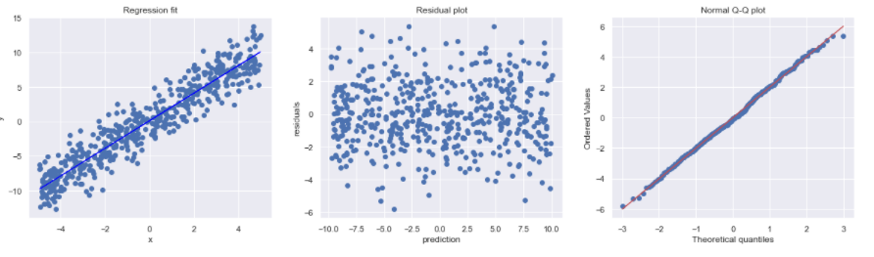
Assumption 1

Slide 15
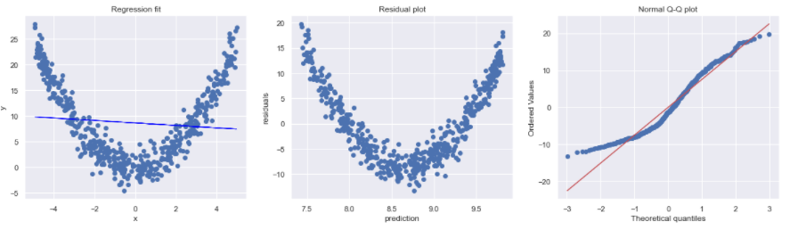

Slide 16

Conclusion
Applied multiple prediction model using liner regression to predict hotels rating.
Our model has a good potential for booking.com for investment since hotels in Makkah by 2030
will host more than 30 million pilgrim per year.
It will enhance booking.com revenue.
Our model prediction able to predict with 0.89 error rate.
In the future we are planning to expand our dataset, add more features and tested with
more assumptions.
In the future we are planning to use our model to predicted the reviews using sentiment analysis methods.

